Slide 1
Welcome to Car Parking Booking App (Easy Parking)
Vivechana Reddy Kottha
EmpID-351941

Slide 2
Introduction
Using this windows mobile application, user can view the number of parking slots, available parking slots in particular location and building and book the parking slots online

Slide 3
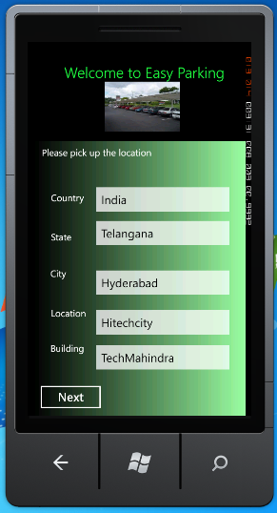
Screen 1-Homepage
Users can select the Country, State, City, Location and building.
User can click on Next to proceed to the next screen

Slide 4
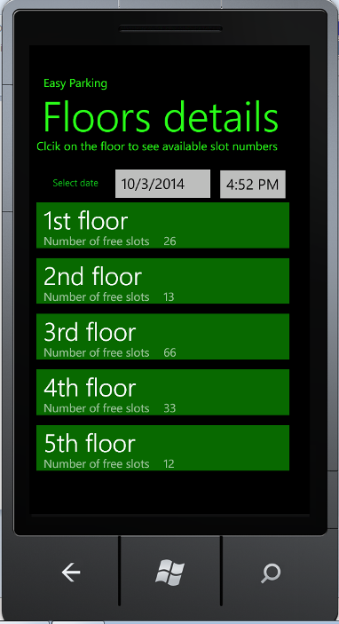
Screen2-Floor details
Based on the selected building. user can see the floor wise number of free slots details
Users can click on the floor to see the available slot numbers and image

Slide 5
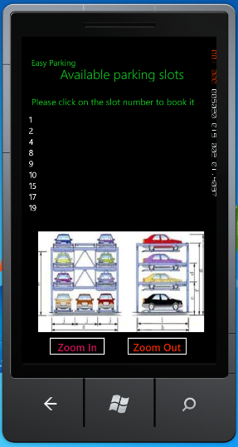
Screen3-Available slot numbers and Image
Based on the selected floor, user can see the available slot numbers and image of the parking floor map
User can click on the parking slot number to proceed with the booking of the parking slot

Slide 6
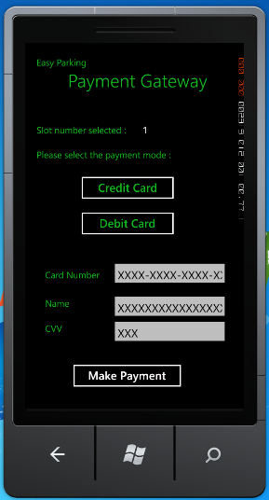
Screen4-Payment Gateway
Based on the slot number selected, user can select the payment options and click on the Make Payment option

Slide 7
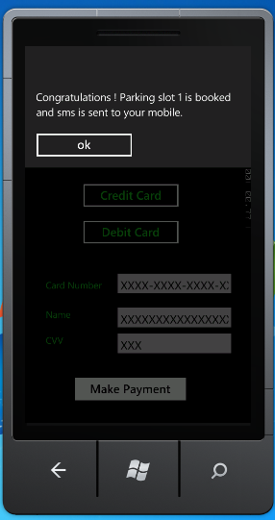
Scree4-Confimration of booking
After successful payment, user will be prompted with message box with the parking slot details booked and sms would be sent to user.

Slide 8
Thank you !

